Slide 1


This packet belongs to:
My Research Handbook
Dear Researcher:
This packet will help you to find information on any topic.
If you need any help along the way, feel free to ask your teacher or to see Mrs. Girolamo in the library.
I have to do what???
Ohh Noo!
Step 1: What do I have to do and when is it due?
Step 2: What am I going to write about?
Step 3: What do I know about it?
Step 4: Where will I find the answers?
Step 5: Organize my ideas
Step 6: Find the information and take notes
Step 7: Write the report
Step 8: How did I do?
Plan:
Do:
Review:
Ridgefield Academy Library Mrs. Girolamo

Slide 2
Research Project Overview
Step 1: What do I have to do?
Plan:
What do I have to write about?
What do I know about it? [inspiration may be helpful!]
What do I have to hand in at the end?
What is my work schedule?
Pick My Topic Date Due: Submitted: Approved:
Outline Date Due: Submitted: Approved:
Notes Date Due: Submitted: Approved:
Works Cited Date Due: Submitted: Approved:
Rough Draft Date Due: Submitted: Approved:
Final Draft Date Due: Submitted: Approved:
Final Project Date Due: Submitted: Approved:
Ridgefield Academy Library Mrs. Girolamo

Slide 3
Research Project Overview
Plan: (continued from the previous page)
Do I have to type it or can it be hand-written?
Typed Hand-written
What computer programs do I have to use?
Word PowerPoint Inspiration
Internet tools (browser, search engine)
None Other:
Do:
Where can I get my information? Do I have to use specific resources?
# needed Home? School Library? Public Library? Someplace Else?
Book
Encyclopedia
Internet site
Elect. database
Magazines
Newspapers
Atlas
Almanac
Other
Ridgefield Academy Library Mrs. Girolamo

Slide 4
Research Project Overview
Do: (continued from the previous page)
Do I have to have pictures? Y N
Where am I going to get the picture from?
A copy from a book? A brochure?
the Internet? Somewhere else?
Are there any other specific requirements that I need to remember?
Review:
Who will be evaluating my work?
Is there a specific rubric I’ll be evaluated from? Y N
Do I have a copy of the rubric? Y N
Ridgefield Academy Library Mrs. Girolamo

Slide 5
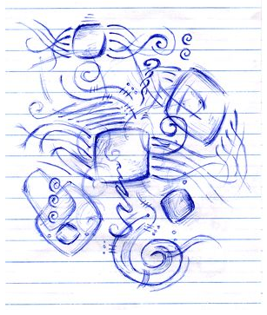
Plan:
Step 2: Choosing your topic – what am I going to write about?
Things to keep in mind:
Pick a topic you have some interest in. Ask yourself: Would it be neat to read about [your topic]? If the answer is no, try to find a topic that you’d like to read about.
Is the topic something that I will find a lot of information about or will researching it be tough? If there isn’t a lot of available information about the topic, am I willing to put in more time trying to locate information?
My topic is:
Step 3: Brainstorming – Ask yourself: what do I know about it?
(put your answer on the worksheet, page 2 of this packet)
President
Civil War
Tall and skinny
John Booth
Assassinated at theatre
Example of brainstorming for a paper on “Abraham Lincoln”
Ridgefield Academy Library Mrs. Girolamo

Slide 6
Plan:
Step 4: Where am I going to find the information I need?
Hint: First stop in your research should be a general reference book - like an encyclopedia – that gives you general information about the subject!
What keywords or phrases can I use to locate the information I need?
Where should I look? Make sure to look at p.3 (question 7) to see if your teacher has asked you to look at specific books, encyclopedias, etc.
Book
Dictionary
Encyclopedia
Internet site
Electronic Database
Magazines
Newspapers
Atlas
Almanac
Other
Ridgefield Academy Library Mrs. Girolamo

Slide 7
Do:
Step 5: Organize my thoughts in an outline
An outline is a way to organize your thoughts, and it gives you an idea of how you will write your report. What should you talk about first? Second? Last?
What might be some of the things you might need to find out about if you have to write a report about a….
…person: early life, education, work, later life?
…place: Origin, history, leaders, geography, economy?
…thing: who, what, when, where, why/how?
Hint: You may want to check encyclopedia subheadings or the table of contents of a book on your topic!
A typical outline:
Introduction: What is your assignment going to be about? Write a thesis statement. A thesis statement is the subject you’ll be writing about. It’s a summary of what your research report will be about.
First Body Paragraph: What are you going to write about?
Second Body Paragraph: What is the next thing I’ll write about?
Third Body Paragraph: What is the next thing I’ll write about?
Conclusion: Tell the reader what you have written about. You restate your thesis statement.
Ridgefield Academy Library Mrs. Girolamo

Slide 8
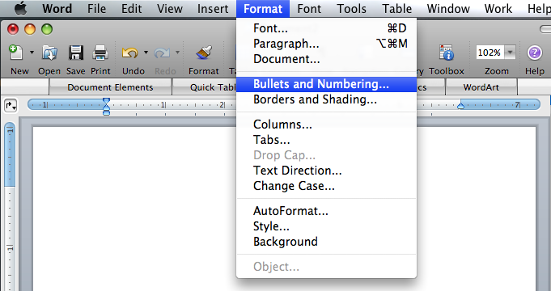
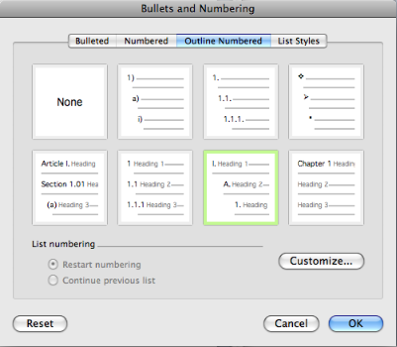
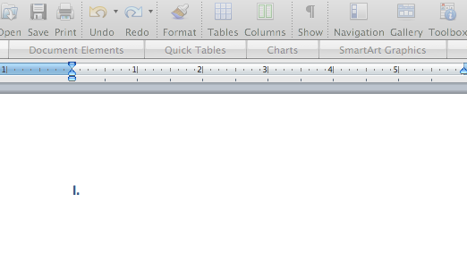
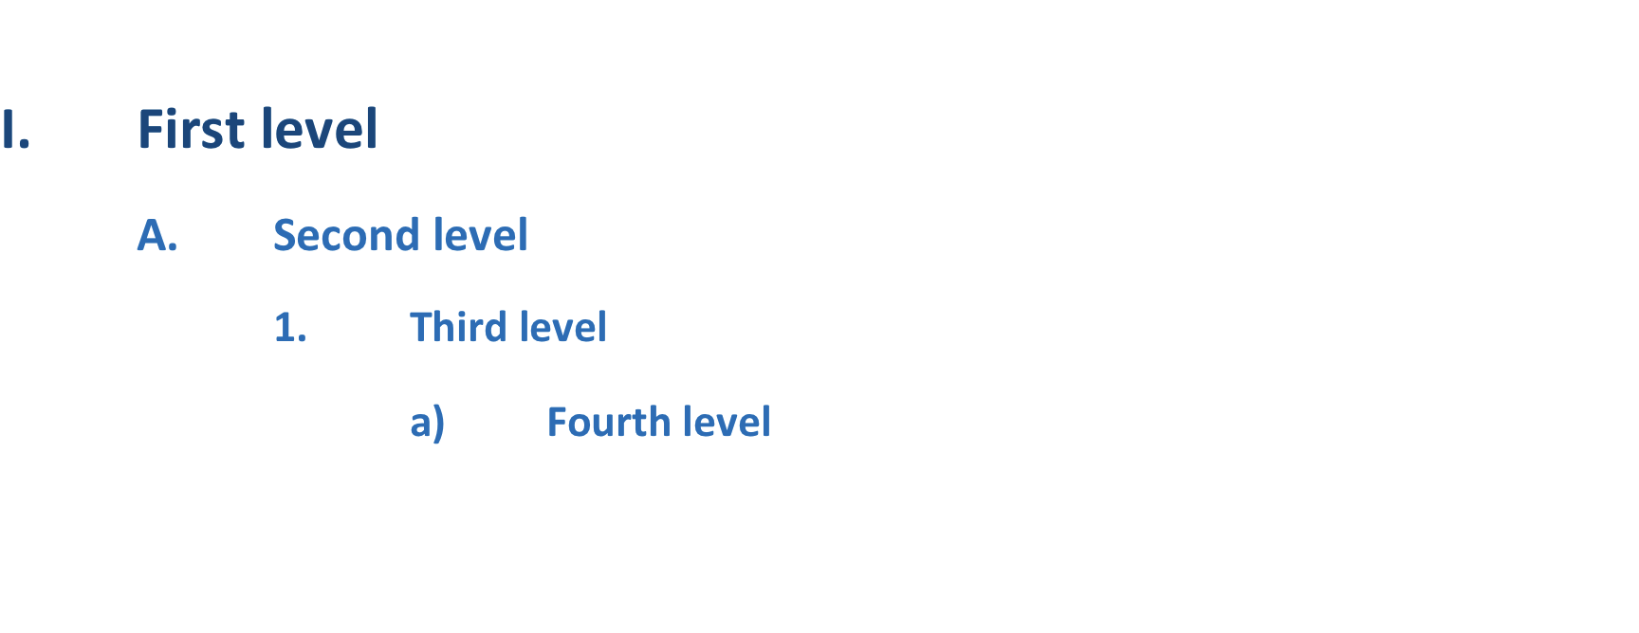
Do:
Tools to use when you outline
An outline is typically typed in a word processing program (like Microsoft Word) or a graphic mapping program like Inspiration. However, an outline can be written also. Before you begin (in the planning) make sure you have a clear idea of what your teacher is requiring for your outline.
This is the standard outline format that is used at Ridgefield Academy (see p.11).
Using Microsoft Word:
1
2
3
4
Hint: The best way to number an outline in Word is to type all the words first – in the right order and using tab on the keyboard for indenting – then highlight all of it. Then format it using Bullets and Numbering.
Ridgefield Academy Library Mrs. Girolamo

Slide 9
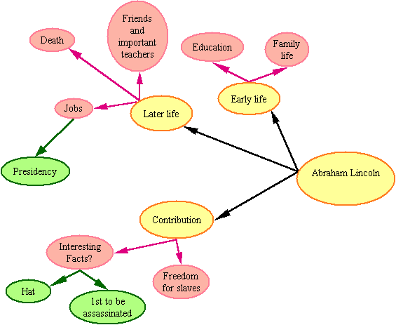
Do:
Using a graphic organizer:
There are several computer programs that allow you to create an outline in ‘bubble’ form. This format is called a graphic organizer or conceptual map.
The graphic program used at Ridgefield Academy is Inspiration. Inspiration will allow you to set up this type of outline and the program will also let you see your graphic outline in number format, like a word processing program.
Again, before you begin (in the planning), make sure you have a clear idea of what your teacher is requiring for your outline – will he or she accept a graphic organizer as an outline, or must I have my outline in a word processing format? (For the accepted word processing format, see the example on page 11.)
Ridgefield Academy Library Mrs. Girolamo

Slide 10
Do:
Outline worksheet
Introduction/thesis:
First thing to talk about
A . A detail?
B. A detail
Second thing to talk about
A . A detail?
B. A detail
Third thing to talk about
A . A detail?
B. A detail
Conclusion (restate thesis):
Ridgefield Academy Library Mrs. Girolamo

Slide 11
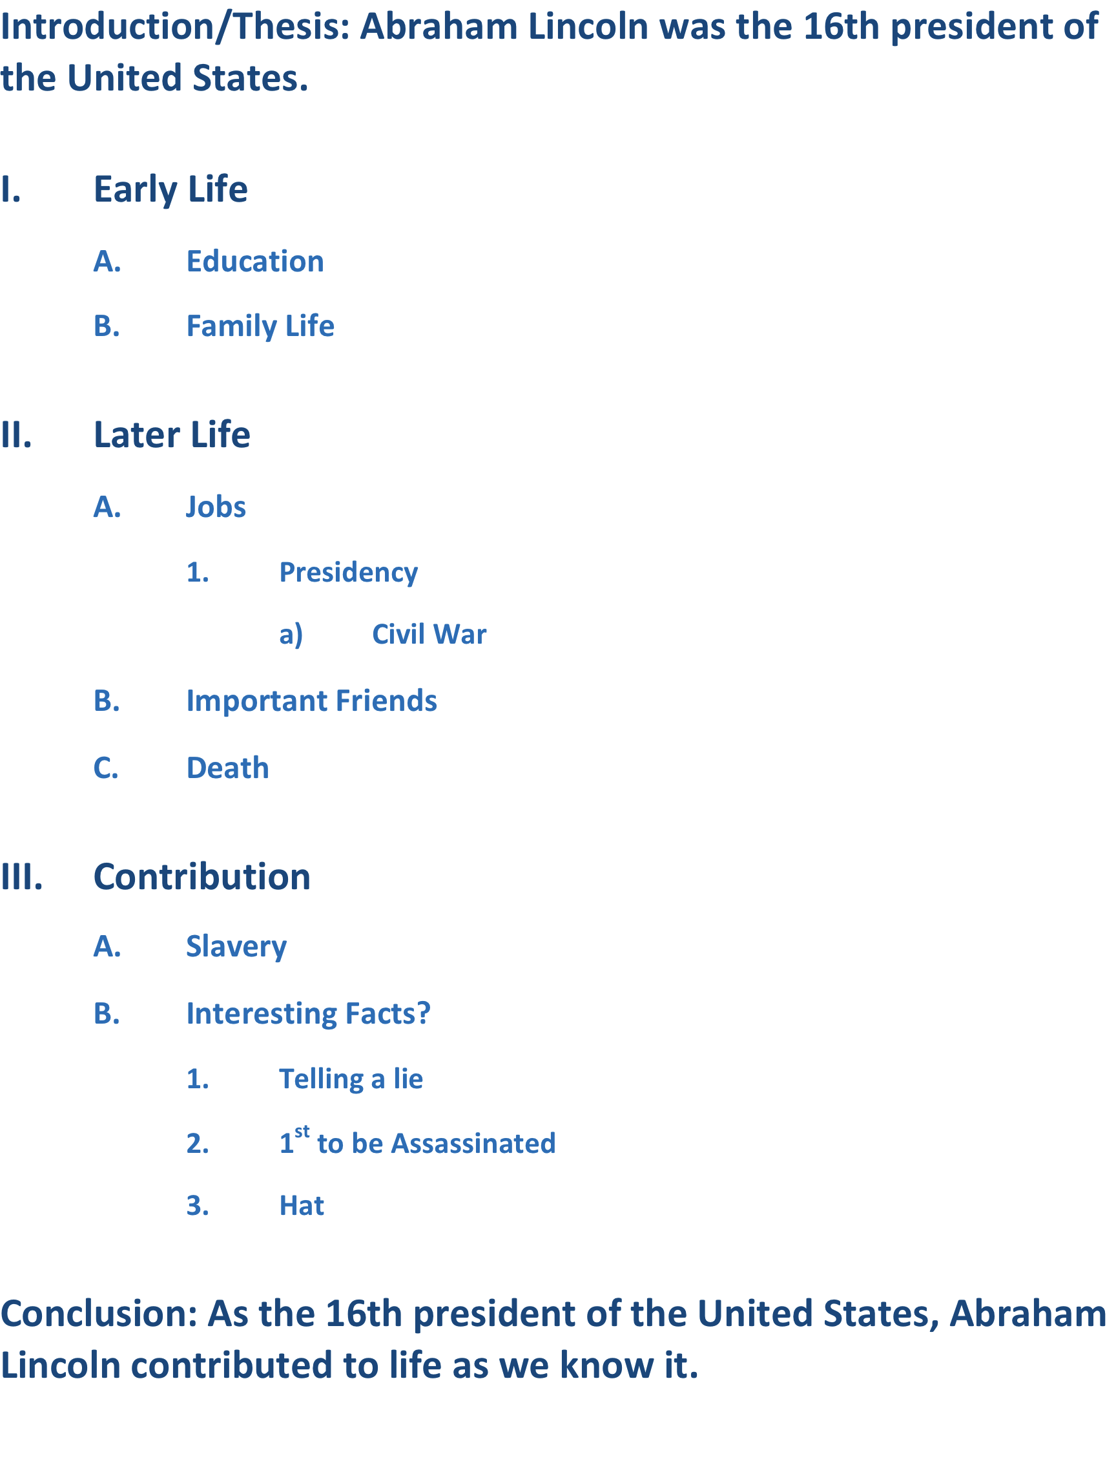
Do:
Outline example
Ridgefield Academy Library Mrs. Girolamo

Slide 12
Do:
Step 6: Find information and take notes
Check the encyclopedia
Focus on what you need to find out. It is so easy to get side-tracked!
Use reliable information (see the information on the Internet below)
Using the internet: Tips and Tricks
Use quotes for internet searches, if you’re looking for a phrase. Otherwise, you will get sites that have the 1st word and 2nd word, but not necessarily together! For example “Miami Dolphins”.
Check that the website is reliable!
Who is the author of the information?
What is the purpose of the website? Is it to
inform, explain or persuade?
When was the information last updated?
Is the information on the website similar to other
information you have received on the
topic?
If you are unsure about whether the information is true, try to verify the information with at least 2 other sources.
Google is not the source of your information – it is a search engine. A search engine goes out into the World Wide Web and hunts for pages that have your search words in them. It then returns a page of search results that you can click on to find more information.
No need to print all the pages out! On your note pages, write down the important information about the site and print just selections or a certain number of pages.
Ridgefield Academy Library Mrs. Girolamo

Slide 13
Do:
To get more reliable information, try searching .edu and .gov sites. Type site:edu or site:gov in your search box, after your search words.
Using electronic databases through Ridgefield Academy
RA pays for you to be able to get to information in electronic form. This information is available through:
Facts4me.com
Culturegrams.com
Worldbookonline.com
You will need a user name and password. Contact Mrs. Girolamo to get them.
Using public library databases
There is a wealth of information available from your local public library, and it is all for FREE! You only need a library card to get to the information.
Record your library card number here: __________________
If you live in Connecticut, you can get to newspapers, magazines, and a whole lot more using a website called:
ICONN.org
From the school library, you do not need a Connecticut library card. If you are trying to search from home, you will need to enter your library card number to get access.
Ridgefield Academy Library Mrs. Girolamo

Slide 14
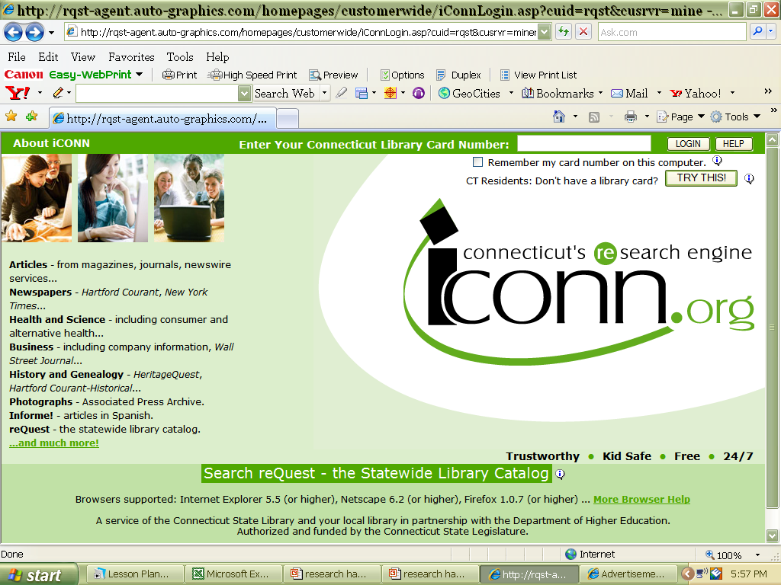
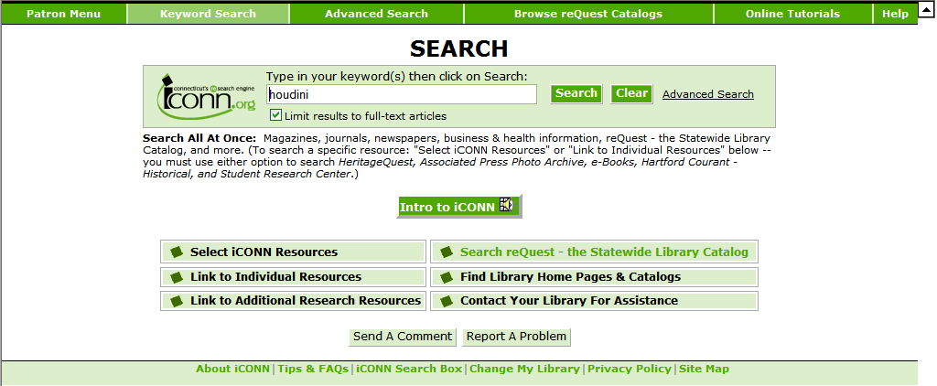
Do:
For Connecticut students,
1. On the internet, go to www.iconn.org .
2. Type in your search terms in the search box and click on .
Ridgefield Academy Library Mrs. Girolamo

Slide 15
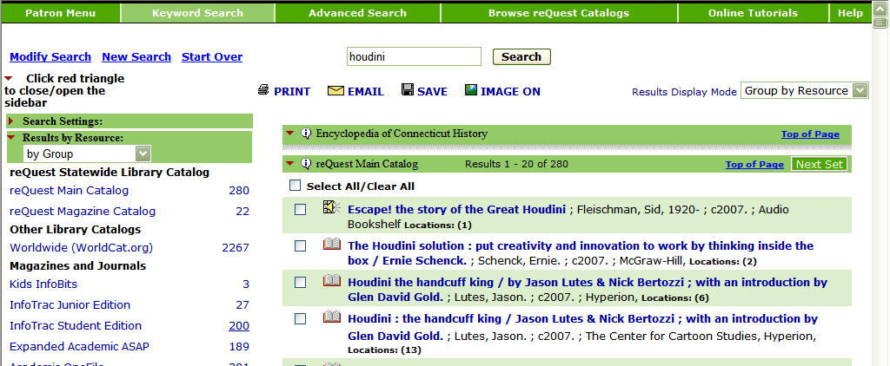
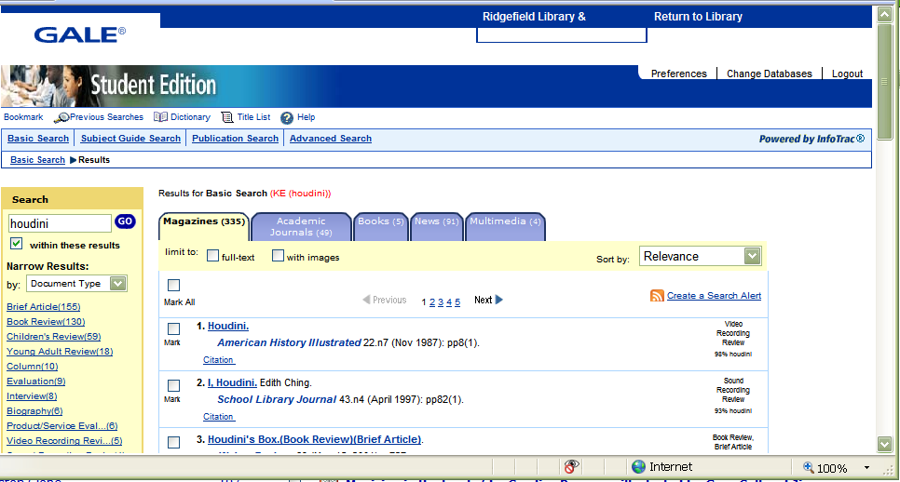
Do:
3. Select
4. Select the articles you would be interested in viewing.
Ridgefield Academy Library Mrs. Girolamo

Slide 16
Do:
Your Connecticut Public Library:
You can access these databases too, through your local public library website. First go to your public library’s website, and look for an option that says ‘online databases’ or something similar. You will need to enter your library card number to get to the information.
Some Connecticut-area Public Libraries:
Ridgefield Public Library www.ridgefieldlibrary.org
Bethel Public Library www.bethellibrary.org
Wilton Public Library www.wiltonlibrary.org
Mark Twain Library www.marktwainlibrary.org
Weston Library www.biblio.org/weston
Danbury Library www.danburylibrary.org
New York students: Follow the instructions beginning on the next page.
Ridgefield Academy Library Mrs. Girolamo

Slide 17

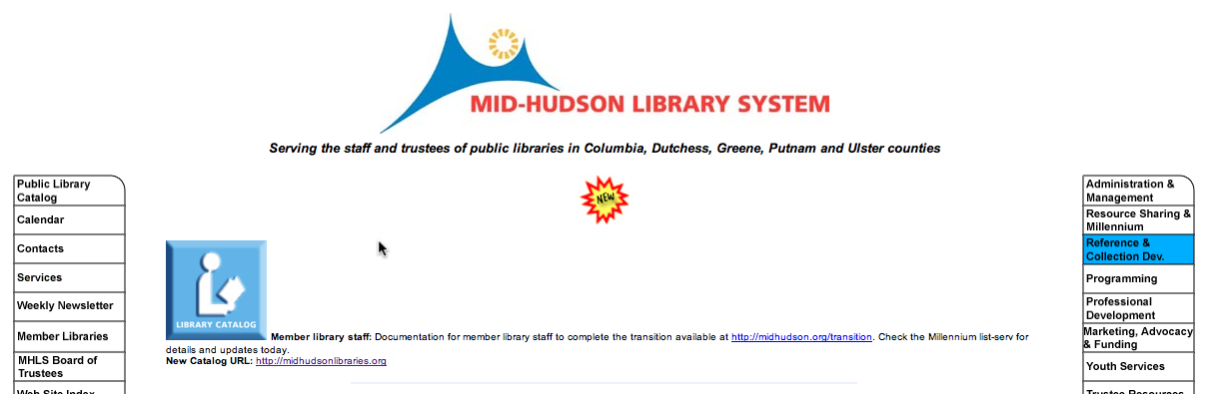
Do:
If you live in New York, you can get to newspapers, magazines, and more information through special websites. If you live in Westchester County, use a website called Westchesterlibraries.org:
When you get to the website, click here.
Select the database you want to look at by clicking on the name.
If you live in Putnam County, use a website called midhudson.org:
Ridgefield Academy Library Mrs. Girolamo

Slide 18
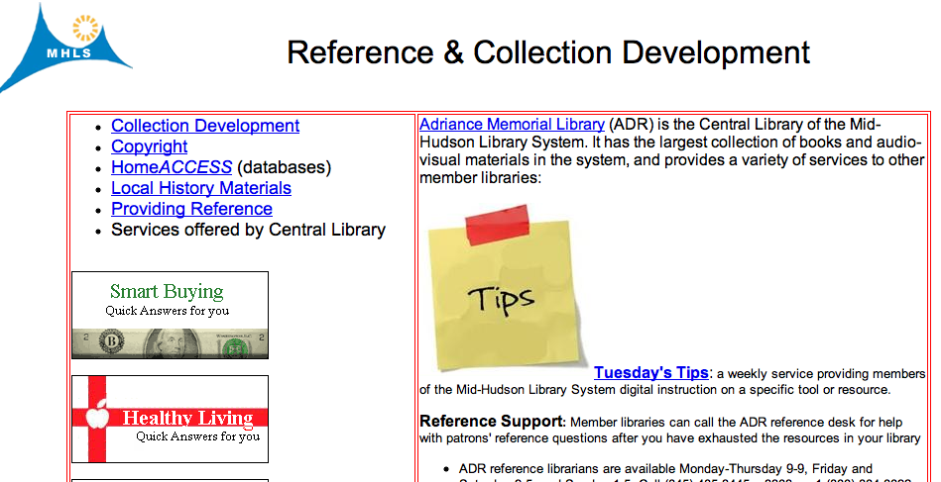
Do:
In midhudson.org, once you have clicked on the ‘Reference and Collection Dev’ button, you will need to click on HomeACCESS to view the databases you can have access to.
Your New York Public Library:
You can access these databases too, through your local public library website. First go to your public library’s website, and look for an option that says ‘online databases’ or something similar. You will need to enter your library card number to get to the information.
Some New York-area Public Libraries:
Brewster Public Library www.brewsterlibrary.org
Somers Public Library www.somerspubliclibrary.org
North Salem Library www.northsalemlibrary.org
South Salem Library www.lewisborolibrary.org
Ruth Keeler Memorial Library www.keelerlibrary.org
Pound Ridge Library www.poundridgelibrary.org
Mahopac Public Library www.mahopaclibrarysite.org
Ridgefield Academy Library Mrs. Girolamo

Slide 19
Do:
Take notes
Tips:
You can take notes on cards, on paper, or on the computer.
Write as much information you can about where you are getting the information from, like title, author, publisher, etc. on your note cards.
Notes are words…not complete sentences!
If you are taking notes about a certain part of your paper like information for paragraph 2, write it on your note card.
Skip what’s unimportant.
Record only facts.
Pull out your outline and make sure you have information (notes) on all the things you plan to write about.
Introduction: What is your assignment going to be about? Write a thesis statement. A thesis statement is the subject you’ll be writing about. It’s a summary of what your research report will be about.
First Body Paragraph: What are you going to write about?
Second Body Paragraph: What is the next thing I’ll write about?
Third Body Paragraph: What is the next thing I’ll write about?
Conclusion: Tell the reader what you have written about. You restate your thesis statement.
Ridgefield Academy Library Mrs. Girolamo

Slide 20
Do:
Step 7: Summarize the information and start writing!
Take out your notes and your outline, and write!
Make a draft and revise, revise, revise!
Use an introductory sentence for each paragraph, and end a paragraph with a sentence that leads to the next paragraph.
Don’t forget the Works Cited page! It’s the last page of your report.
A note on doing your own work:
Plagiarism means taking a piece of writing that has been copied from someone else and passing it on as your own work.
Plagiarism is against Ridgefield Academy rules.
If you want to use someone else’s words, make sure you give them credit for their work!
Ridgefield Academy Library Mrs. Girolamo

Slide 21
Do:
Writing paragraphs - worksheet
Introduction/Thesis: What am I going to be writing about?
Paragraph I: What is the main idea or subject for this paragraph?
What are some examples or explanations or facts that I can add about this idea?
A.
B.
C.
D.
Paragraph II: What is the main idea or subject for this paragraph?
What are some examples or explanations or facts that I can add about this idea?
A.
B.
C.
D.
Paragraph III: What is the main idea or subject for this paragraph?
What are some examples or explanations or facts that I can add about this idea?
A.
B.
C.
D.
Conclusion: What did I write about? What did my information show?
Ridgefield Academy Library Mrs. Girolamo

Slide 22
Do:
Don’t forget the Works Cited!
Remember: The whole idea of a works cited is to have enough information so that the reader could easily find the materials you used for your report. If certain information is not available, just leave it out, and record the next thing that you need.
Also, please remember to add the words Print or Web so that the reader knows where to go, to find the information.
There are several electronic programs that will compile a works cited for you, like easybib.com; just remember to gather all of this information as you are taking notes!
Books:
One author:
___________,____________. ______________________.
Author’s last name, first name. Title of Book (in italics)
____________: ____________, ________. Print.
City of Publication: Publisher, Year of Publication.
Example:
Henley, Patricia. The Hummingbird House. Denver: MacMurray,
1999. Print.
Two authors:
Same as above, with one major difference:
________, _____ and _________.
Author’s last name, first name first and last name of 2nd author.
The first author listed is the one who’s last name appears first in alphabetical order.
Ridgefield Academy Library Mrs. Girolamo

Slide 23
Do:
For more than two authors, follow the same format, except when listing the author.
________,______ , et.al.
Author’s last name, first name first and last name of 2nd author.
The only author listed is the one who’s last name appears first in alphabetical order.
PRINT Encyclopedia:
___________,____________. “___________.”_____________.
Author’s last name, first name. “Article Title.” Encyclopedia (in italics)
____________: _________, ________.____-____.Print.
City of Publication: Publisher, Year of Edition. Page Numbers. Print.
Example:
Donovan, Mary. “Caterpillars.” The World Book Encyclopedia. Chicago: World Book, 2006. 210-13. Print.
Electronic Databases such as worldbookonline, culturegrams, facts4me:
___________,____________. “___________.”_____________.
Author’s last name, first name. “Article Title.” Database name (italics).
Web . ___ ___ ___. < ________>.
Day Mth. Year. Web address.
Example:
Donovan, Mary. “Caterpillars.” The World Book Online. Web.
10 Oct. 2012. http://worldbookonline.com.
Ridgefield Academy Library Mrs. Girolamo

Slide 24
Do:
NOTE:
Whenever dates are used in a works cited, they are always listed as date month year, and the month is abbreviated.
When noting a website and the website address is long, just note up to the third slash ‘/’; the reader should be able to get to the page you are referring to without having to type in a very long address.
A Personal Interview:
_________, ________. Personal Interview. ___ ___ ___.
Person’s last name, first name. Personal Interview. Day Mth Year.
Example:
Purdue, Pete. Personal Interview. 1 Dec. 2000.
Magazine or Newspaper:
___________, ____________. “_____________________.”
Author’s last name, first name. “Title of Article.” (in quotes)
__________________.___ ___ ___: ________. Print.
Mag./News. Name. (italics) Day Mth. Year: page numbers. Print.
Example:
Poniewozik, James. "TV Makes a Too-Close Call." Time. 20
Nov. 2000: 70-71. Print.
Ridgefield Academy Library Mrs. Girolamo

Slide 25
Do:
If online (like from a library database), same as above except after the Day Month and Year, write this:
.Web. ___ ___ ___ . < _________________>.
Day Mth. Year (you got the information). <web address>.
Example:
Poniewozik, James. "TV Makes a Too-Close Call." Time. 20
Nov. 2000. Web. 16 Oct. 2012. <http://time.com/1234>.
Internet Site: [Remember: record as much information as is available! If you cannot get a part of this information because it is not on the website, leave it out.]
___________,____________. “___________.”_____________.
Author’s last name, first name. “Article Title.” Web Page Title (in italics)
___________,__ __ __.Web . ___ ___ ___. < ________>.
Sponsoring Day Mth. Year Web. Day Mth. Year <Web address>.
Company, of the article. you went online.
Example:
Wolford, Ron. “Worm Facts.” Worm Facts. Urban Process
Resource Network, 10 Jan. 2012. Web. 16 Oct. 2012.
<http://www. rbanext.illinois.edu/worms/facts>
An example with an unknown author:
“Worm Facts.” Worm Facts. Urban Process
Resource Network, 10 Jan. 2012. Web. 16 Oct. 2012.
<http://www. rbanext.illinois.edu/worms/facts>
Ridgefield Academy Library Mrs. Girolamo

Slide 26
Do:
Works Cited Form (for more explanations, see pages 22-25)
Books with 1 author:
Author’s last name, first name. Book Title (italics). City of Publication: Publisher, Year of
Publication, Print (or Web).
Books with 2 authors:
Author’s last name, first name and 2nd author’s first and last name. (the rest of the information is the same as above, ”books with one author”)
Books with more than 2 authors:
Author’s last name, first name, et.al. (the rest of the information is the same as above, “books with one author”)
Encyclopedia (Book):
Author’s last name, first name. “Article Title.” Name of Encyclopedia (italics). City of Publication: Publisher, Year of Edition. Page Numbers. Print.
Electronic Database (i.e. worldbookonline, facts4me, culturegrams):
Author’s last name, first name. “Article Title.” Name of Database (italics). Web. Day Mth. Year of article. <Web address>.
Internet:
Author’s last name, first name. “Article Title.” Web Page Title (in italics). Sponsoring Company. Day Mth. Year it was last updated. Web. Day Mth. Year you went online. <Web address>.
Personal Interview:
Person’s last name, first name. Personal Interview. Day Mth Year.
Magazine/Newspaper
Author’s last name, first name. “Title of Article.” (in quotes). Mag./News. name (italics). Day Mth. Year: page numbers. Print.
(Online: Instead of ‘Print’, write Web and Day Mth. Year you got the information. <web address>.)
Ridgefield Academy Library Mrs. Girolamo

Slide 27

Do:
Typed Works Cited - example
John Smith
Works Cited
Davidson, Margaret. The Story of World War II.
New York: Scholastic Inc., 1990.
Jenkins, Reese V. “World War II –
Consequences.” World Book Encyclopedia,
2002 ed.
Johnson, Ruth Spencer. “The World at War”
Cobblestone Magazine, December 2005: 6-8.
The Library of Congress. “Memories of the
Holocaust.” American Memory Library of
Congress. 6 June 1999. 3 February 2006.
<http://memory.loc.gov/ammem>
Indent 2nd lines
ABC order
Date formats: day month year
Important!
Alphabetize list by the first word.
Double space between entries.
Indent the second, third, etc. lines of each entry by 5 spaces.
Use < > around web addresses; if the address is too long, write down the address up to the third slash ‘/’.
Date format is: day month year. Example: 3 Feb. 2006.
Ridgefield Academy Library Mrs. Girolamo

Slide 28
Do:
Do I have everything?
A Research Paper must include:
Completed:
A title page
An introductory paragraph,
A body of facts and details,
A conclusion
A works cited page
Powerpoint presentation should include: A title slide, introductory slide, body slides, conclusion and works cited.
Any special requirements? Y N
Slide 1:
Slide 2:
Slide 3:
Slide 4:
Slide 5:
Ridgefield Academy Library Mrs. Girolamo

Slide 29
Do:
(continued)
Slide 6:
Slide 7:
Slide 8:
Slide 9:
Slide 10:
Slide 11:
Slide 12:
Slide 13:
Slide 14:
Ridgefield Academy Library Mrs. Girolamo

Slide 30
Do:
Tips and Tricks for Powerpoint Presentations
Always start working with an outline
Write your content before adding pictures, sound, etc.
Use only pictures/graphics that match what you are talking about on the slide
Choose dark font on a light, simple background – don’t distract your audience with other ‘stuff’ on a slide
Use simple fonts
Use bold or italics for important key words – don’t use caps or underlining
Use the Rule of Six:
* six words per line (main ideas)
* six lines per slide
Check spelling and grammar
REMEMBER: A slide is meant to introduce something; it’s not meant for details. You talk about the details!
Taken (revised) from “The Rules of an Effective Powerpoint”, Our Librarian Won’t Tell Us ANYTHING! Library Lessons 2006, Toni Buzzeo (UpstartBooks)
Ridgefield Academy Library Mrs. Girolamo

Slide 31
Review:
Step 8: How did I do?
How do I think I did? Did I learn anything from this project?
Should I do anything differently the next time I am asked to research a similar subject?
If there is a specific rubric for your project, evaluate yourself using that rubric. If no rubric is available, use the rubric on the next page to evaluate your performance.
(If you are using the rubric on the next page) What would I give myself for each of these categories?
(assign a number of 1 for Unsatisfactory, 2 for Good or 3 for Excellent )
Notes:
Paragraphs:
Spelling and punctuation:
Graphics:
Answering all questions:
My sources:
Works Cited:
My attitude:
1
2
3
1
2
3
1
2
3
1
2
3
1
2
3
1
2
3
1
2
3
1
2
3
Ridgefield Academy Library Mrs. Girolamo

Slide 32
Review:
A Research Rubric
Excellent
3
Good
2
Unsatisfactory
1
Research Notes
Notes are recorded and organized in an extremely neat and orderly fashion.
Notes are recorded legibly.
Notes are not recorded.
Paragraph
All paragraphs include introductory sentence, explanations or details, and concluding sentence.
Most paragraphs include introductory sentence, explanations or details, and concluding sentence.
Paragraphing structure was not clear and sentences were not typically related within the paragraphs.
Mechanics
No grammatical, spelling or punctuation errors.
A few grammatical, spelling or punctuation errors
Many grammatical, spelling, or punctuation errors.
Graphics
Multiple graphics were used to illustrate the research point(s).
One picture was used to illustrate the research point(s).
No pictures were used.
Amount of Info.
All topics are addressed and all questions answered with at least 2 sentences about each.
All topics are addressed.
One or more topics were not addressed.
Quality of Info.
Information provides answers to the main questions along with several supporting details and/or examples for each.
Information provides answers to main questions.
Information is not provided for all of the main questions.
Sources
Used more than 1 source from the required source types.
Used 1 source from each of the required source types.
Did not use all of the required source types.
Work Cited
Complete work cited page in the correct format.
Complete work cited page, with some attempt at the correct format.
Incomplete or no work cited page.
Effort
The student went above and beyond what was required.
The student made an effort to understand the project and what was required.
The student made no effort to participate in the project.
Attitude
Approached the project with great enthusiasm and eagerness.
Student expressed some interest in the project and worked diligently.
Student had no interest in completing the project and showed poor behavior during project time.
Ridgefield Academy Library Mrs. Girolamo

